Slide 1
Discrete Probability

Slide 2

Definitions
A trial is a procedure that yields one of a set of possible outcomes. A sequence of trials is an experiment.
Flipping a coin is a trial.
The sample space is the set of possible outcomes
{heads, tails, on edge}
An event is a subset of the sample space
{heads, on edge}
You roll two dice, and are wondering if you’ll get snake eyes (two 1’s).
What is the trial?
Rolling two dice
What is the sample space?
{1,2,3,4,5,6} x {1,2,3,4,5,6}
What is the event?
Snake eyes
What is the probability of the event?
1/36

Slide 3
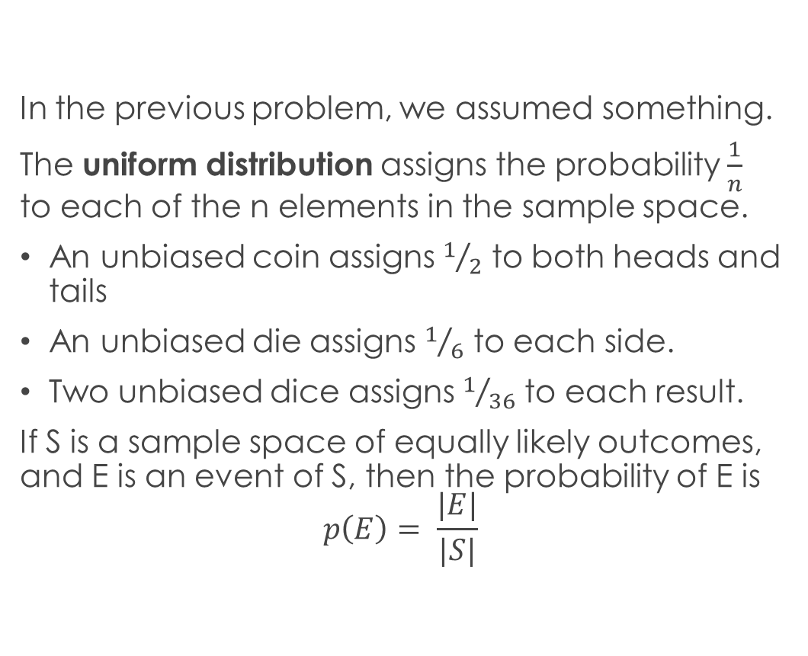
The Uniform Distribution
In the previous problem, we assumed something.
The uniform distribution assigns the probability $\frac{1}{n}$ to each of the n elements in the sample space.
An unbiased coin assigns $1/2$ to both heads and tails
An unbiased die assigns $1/6$ to each side.
Two unbiased dice assigns $1/{36}$ to each result.
If S is a sample space of equally likely outcomes, and E is an event of S, then the probability of E is
$$p\left(E\right)= \frac{|E|}{|S|}$$

Slide 4

Practice
What is the probability that the sum of two dice rolls is 7?
$$\frac{6}{36}= \frac{1}{6}$$
How many 5-card Poker hands are there?
$$\left({52 \atop 5}\right)$$
How many 5-card Poker hands contain a 4-of-a-kind?
13 ∙ 48
What is the probability of a 4-of-a-kind?
$\frac{\text{13 ∙ 48 }}{\left({52 \atop 5}\right)}$ = 0.024%
What is the probability of a full house?
$$\frac{\text{13}\text{P}\text{2}∙ \left({4 \atop 3}\right)\left({4 \atop 2}\right)}{\left({52 \atop 5}\right)}$$

Slide 5

Inverting Probabilities
You have a sequence of 10 bits, generated by the uniform distribution. What is the probability that at least one bit is a 0?
$$1−1/{210}$$
Given event E in sample space S, the probability of the complement of E is:
$$p\left(\overline{E}\right)=1 − p(E)$$

Slide 6

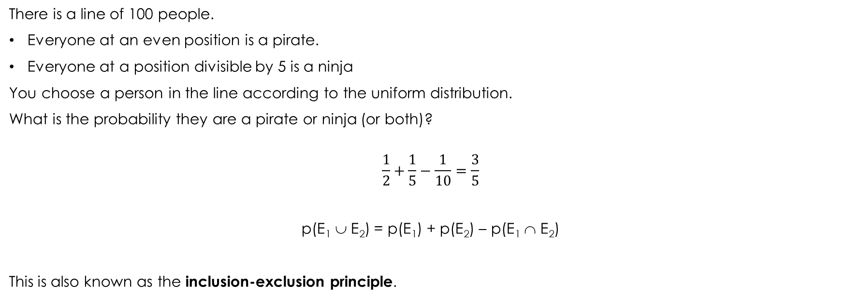
The Subtraction Rule for Discrete Probabilities
There is a line of 100 people.
Everyone at an even position is a pirate.
Everyone at a position divisible by 5 is a ninja
You choose a person in the line according to the uniform distribution.
What is the probability they are a pirate or ninja (or both)?
$$\frac{1}{2}+\frac{1}{5}−\frac{1}{10}=\frac{3}{5}$$
p(E₁ ∪ E₂) = p(E₁) + p(E₂) – p(E₁ ∩ E₂)
This is also known as the inclusion-exclusion principle.

Slide 7
The Monty Hall Three-Door Puzzle
There are three doors.
Behind one is a car.
Behind each of the other two doors is a goat.
You choose one door, but don’t open it.
The gameshow host knows where the car is.
The gameshow host intentionally chooses a door which you did not choose, which does not have the car, and opens it, revealing a goat.
You can now open the door you originally chose, or the other closed door.
What should you do?

Slide 8

Monty Hall
Intuition A: there are two doors left, and each is equally likely, so it doesn’t matter which door you open.
Intuition B: when you guessed which door to open, you had a $1/3$ chance of it having a car. That is still the case, so the other doors has a $2/3$ probability of a car. So, you should switch doors.
Intuition B is correct. Why?

Slide 9
Monty Hall Rephrased
There are three doors.
Behind one is a car.
Behind each of the other two doors is a goat.
You choose one door (door A), but don’t open it.
The gameshow host knows where the car is.
The gameshow host decides to give you a hint. He tells you that if the car is behind door B or C, then it is not behind door C. To drive the point home, he opens door C to reveal a goat.
By switching to door B, you effectively get to open two doors and take the better of the prizes.

Slide 10

Monty Hall for the unconvinced
There are 100 doors.
Behind one is a car.
Behind each of the other 99 doors is a goat.
You choose one door (door 1), but don’t open it.
The gameshow host knows where the car is.
The gameshow host opens 98 other doors, not including your door, and not including the door with the car.
Does the probability you originally chose the correct door magically increase from $1/{100}$ to $1/2$? (No)

Slide 11
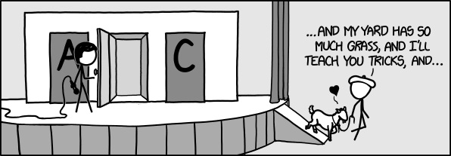
XKCD #1282: Monty Hall

Slide 12
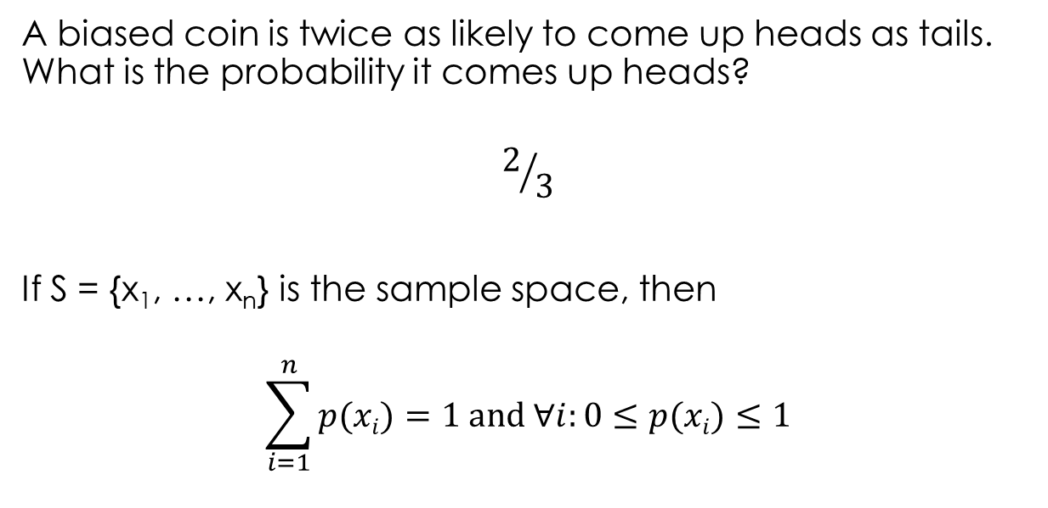
Non-Uniform Distributions
A biased coin is twice as likely to come up heads as tails. What is the probability it comes up heads?
$$2/3$$
If S = {x₁, …, x_{n}} is the sample space, then
$$\sum_{i=1}^{n}{p(xi)}=1 and ∀i:0≤p(xi)≤1$$

Slide 13
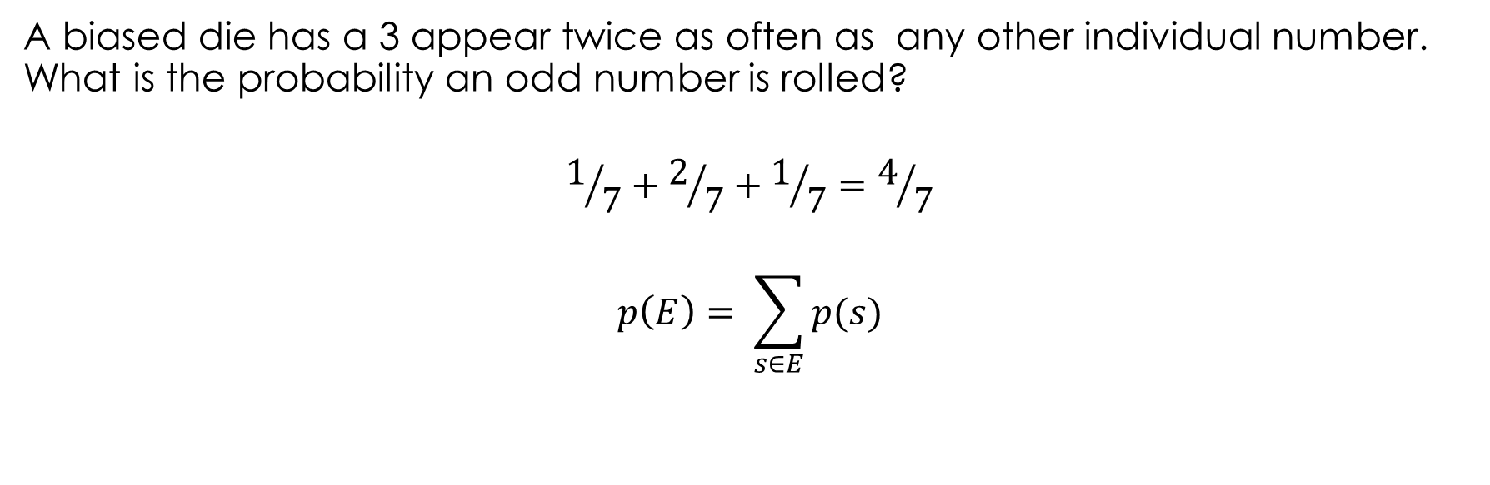
The Sum Rule for Probability
A biased die has a 3 appear twice as often as any other individual number. What is the probability an odd number is rolled?
$$1/7+2/7+1/7=4/7$$
$$p\left(E\right)= \sum_{s∈E}{p(s)}$$

Slide 14
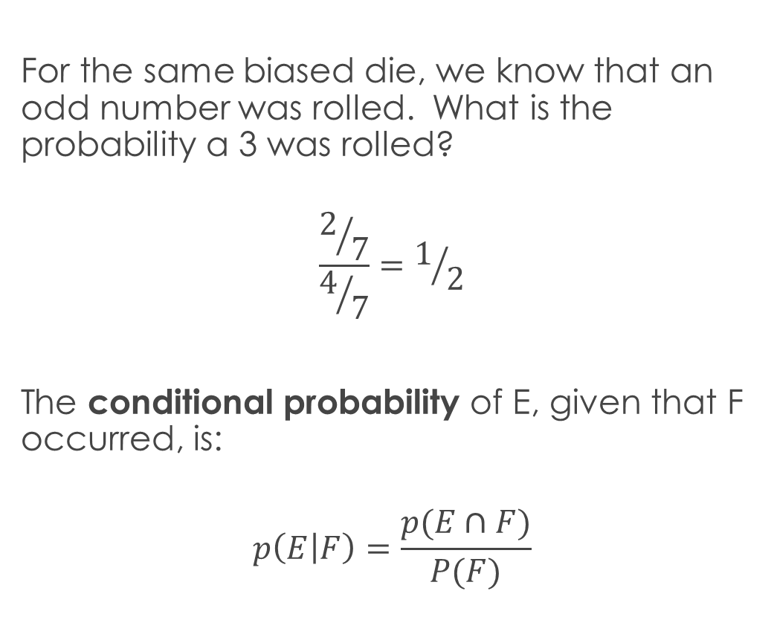
Conditional Probability
For the same biased die, we know that an odd number was rolled. What is the probability a 3 was rolled?
$$\frac{2/7}{4/7}=1/2$$
The conditional probability of E, given that F occurred, is:
$$p\left(E | F\right)=\frac{p(E∩F)}{P(F)}$$

Slide 15

Practice
There are 4 people in line. Each person is either a pirate or a ninja (but not both), assigned by the uniform distribution. What is the probability there are two consecutive ninja, given the first person in line is a ninja?
NNPP
NNPN
NNNP
NNNN
NPNN
$$5/8$$

Slide 16

Practice
A family has two children, the gender is generated u.a.r. (uniformly at random) What is the probability of two boys, given the youngest is a boy?
$$1/2$$
A family has two children, the gender is generated u.a.r. (uniformly at random) What is the probability of two boys, given at least one boy?
Intuition A: This is just the same problem, right? So it is $1/2$?
Intuition B: There are 3 possible events: BG, GB, BB. So it is $1/3?$
Intuition B is correct.

Slide 17

For the Unconvinced
Gather data from all U.S. families with exactly 2 children (lets say there are 10 million).
2.5 million families have two girls.
2.5 million families have two boys.
2.5 million families have BG.
2.5 million families have GB.
Given there is at least one boy, there are 7.5 million families we might have selected from.
Of them, $1/3$ of them have two boys.

Slide 18

The Law of Total Probability
For any partition of the sample space into disjoint events $F1, …, Fk$ Where $F1∪ … ∪Fk = S$ and $F1 ∩ … ∩ Fk = ∅$:
$$p(E) = p(E|F1) ∙ p(F1) + … + p(E|Fk) ∙ p(Fk)$$
Because:
$$p\left(E\right)= \frac{p(E∩F1)}{p(F1)}∙p\left(F1\right)+ … +\frac{p(E∩Fk)}{p(Fk)}∙p\left(Fk\right)$$
$$=p\left(E∩F1\right)+ … +p(E∩Fk)$$

Slide 19
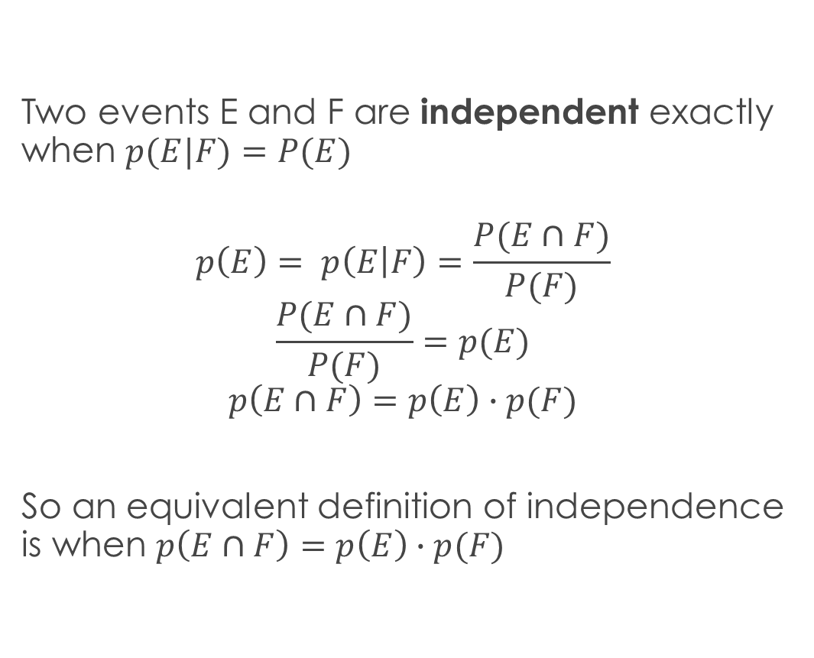
Definitions
Two events E and F are independent exactly when $p(E|F)=P(E)$
$$p\left(E\right)= p\left(E | F\right)=\frac{P(E∩F)}{P(F)}$$
$$\frac{P(E∩F)}{P(F)}=p(E)$$
$$p\left(E∩F\right)=p\left(E\right)∙p(F)$$
So an equivalent definition of independence is when $p\left(E∩F\right)=p\left(E\right)∙p(F)$

Slide 20


Practice
A family has 2 children, the gender is determined u.a.r. The event E is when there are two girls. F is when there is at least one girl. Are E and F independent?
No. $p\left(E\right)=1/4 p\left(F\right)=3/4 p\left(E\right)∙p\left(F\right)=3/{16} p\left(E∩F\right)=\frac{1}{4}$
The family has 3 children. E is when there is a boy and a girl. F is when there is at most 1 boy. Are E and F independent?
Yes. $p\left(E\right)=3/4 p\left(F\right)=1/2 p\left(E\right)∙p\left(F\right)=3/8 p\left(E∩F\right)=\frac{3}{8}$
There are 4 people in line. Each person is a pirate or ninja (not both), generated u.a.r. E is when the first person is a ninja. F is when there are an even number of ninjas. Are E and F independent?
Yes. $p\left(E\right)=1/2 p\left(F\right)=1/2 p\left(E\right)∙p\left(F\right)=1/4 p\left(E∩F\right)=\frac{1}{4}$

Slide 21


Practice
You have a jar with 6 red marbles and 4 blue marbles.
You draw 3 of them from the jar, u.a.r.
Let E be the event where not all marbles are the same color.
Let F be the event where the first marble drawn is red.
Are E and F independent?
$$p\left(F\right)= 3/5$$
$$p\left(\overline{E}\right)= \frac{\left({6 \atop 3}\right)+\left({4 \atop 3}\right)}{\left({10 \atop 3}\right)}=1/5 p\left(E\right)= 4/5$$
$$p\left(E∩F\right)=3/5∙\left(1−5/9∙1/2\right)={13}/{30}$$
Not independent!

Slide 22

Indendence of many events
Events E₁, … E_{n} are pairwise independent if every pair of events are independent.
They are mutually independent if, for any subset of events, they are independent.
Events F₁, …, F_{k} are independent if
$$p\left(\text{F}\text{1}∩ … ∩\text{F}\text{k}\right)=p\left(\text{F}\text{1}\right)∙ . .. ∙p(\text{F}\text{k}\text{)}$$

Slide 23

Practice
Consider 2 fair coin flips.
E₁ is the event where the first flip is heads.
E₂ is the event where the second flip is heads.
E₃ is the event where exactly one flip is heads.
Are these pairwise independent? Mutually independent?
p(E₁) = p(E₂) = p(E₃) = $1/2$
p(E₁ $∩$ E₂) = p(E₁ $∩$ E₃) = p(E₂ $∩$ E₃) = $1/4$
p(E₁ $∩$E₂ $∩$E₃) = 0
Pairwise, but not mutual.

Slide 24

Practice
An integer between 1 and 8 inclusive is chosen u.a.r.
E₁ is the event that the number is ≤ 4.
E₂ is the event that the number is odd.
E₃ is the event that the number is prime.
Pairwise independent? Mutually independent?
p(E₁) = p(E₂) = p(E₃) = $1/2$
p(E₁ $∩$E₂ $∩$E₃) = $1/8$
p(E₂ $∩$E₃) = $3/8$
Neither!

Slide 25


The Birthday Paradox
What are the odds that two people watching this lecture share the same birthday? Is it above or below 50%?
Assume that any of the 366 possible birthdays are equally likely.
The probability that among n people, two have the same birthday, is:
$$1−\frac{366}{366} ∙ \frac{365}{366} ∙ \frac{364}{366} ∙ … ∙ \frac{367−n}{366}$$
n = 10: 11.7%
n = 23: 50.7%
n = 30: 70.6%
n = 50: 97%
n = 70: 99.9%
n=367: 100%

Slide 26


Bernoulli Trials
A Bernoulli Trial is a trial with 2 outcomes that may or may not have equal probability. One outcome is the success with probability p, the other is the failure with probability q = 1-p.
If you have an experiment of n identical Bernoulli trials, the probability of getting exactly k successes is:
$$\left({n \atop k}\right)pkqn−k$$
This looks like the Binomial Theorem!

Slide 27

Practice
A biased coin has probability of heads $2/3$. Given 4 flips, what is the probability of exactly 2 heads?
$$\left({4 \atop 2}\right)∙2/32∙1/32=30\%$$
There are 10 people in line. Each person has a 90% chance of being a pirate, and is otherwise a ninja. What is the probability of exactly 8 pirates?
$$\left({10 \atop 2}\right)∙1/{10}2∙9/{10}8=19\%$$

Slide 28


Randomized Algorithms
Suppose a group of size n got together yesterday, and they’re worried that they contracted coronavirus during this gathering.
Let’s say that enough social mingling occurred that if even one person had it, then each person now has a 10% of having it now.
You could test everyone from the gathering, but that’s not feasible given the limited number of tests we have.
Instead, you can test k of the members (chosen u.a.r.), and assert that if no one tests positive, then no one contracted the virus at the gathering.
If no one actually contracted the virus, what is the probability you will assert as much?
100%
If someone did contract the virus, what is the probability you will incorrectly assert that no one did?
$(9/{10})$^{k}
If k = 66, this is < 0.1%. If k = 132, this is < 0.0001%

Slide 29
Randomized Algorithms
This was an example of a Monte Carlo randomized algorithm: such an algorithm is always fast, but sometimes returns the wrong answer.
When you get to them in CSCI 104, you will see that a Bloom Filter is a Monte Carlo data structure.
The other type of randomized algorithm is a Las Vegas algorithm: it is always right, but sometimes takes a long time.
QuickSort, and HashTables, are examples of this type.

Slide 30
The Prosecutor’s Fallacy
You are accused of speeding.
The prosecutor notes that you have a radar detector (it detects when police are using their radar system which identifies speeders).
The prosecutor also notes that 80% of speeders have radar detectors, so you are probably guilty.
Is there any flaw in his reasoning?
It could be that 1% of the population speeds, but 80% of all drivers have radar detectors, for example. Now the same argument indicates you probably aren’t guilty!
The fallacy is mistaking p(E|F) for p(F|E)

Slide 31
Simpson’s Paradox
Alice and Bob are studying for the CSCI 104 midterm. They each do 25 practice problems, split over 2 types (graphs and probability).
Bob does 5 graph problems, and gets 3 of them right.
Alice does 20 graph problems, and gets 13 of them right.
Bob does 20 probability problems and gets 15 of them right.
Alice does 5 probability problems and gets 4 of them right.
Bob got a 60% on graphs, Alice got a 65% (Alice did better).
Bob got a 75% on probability, Alice got an 80% (Alice did better).
Bob got 18 out of 25 problems right, Alice got 17 out of 25 right (Bob did better overall).

Slide 32
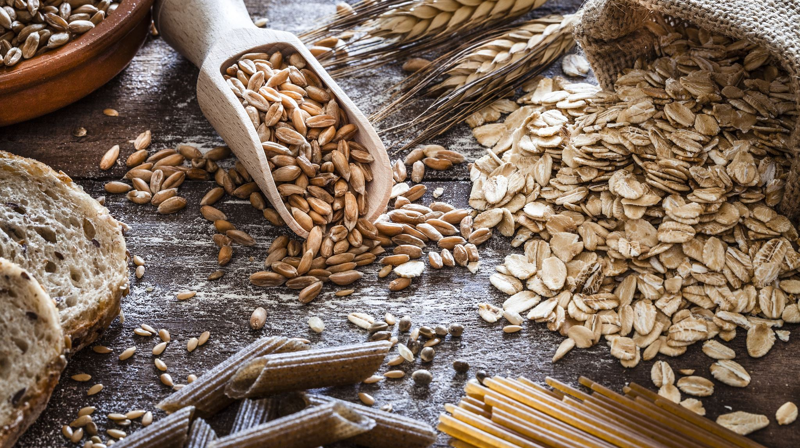
Simpson’s Paradox
A new study promotes the benefits of a specific diet.
3 out of 8 of the residents of Roshar survive to age 70 on diet 1.
40 out of 90 of Roshar residents survive on diet 2.
60 out of 92 of the residents of Tyrea survive to age 70 on diet 1.
7 out of 10 of Tyrea residents survive on diet 2.
63% of people on diet 1 survive, vs. 47% on diet 2.
This is not enough information to extol the benefits of diet 1!

Slide 33
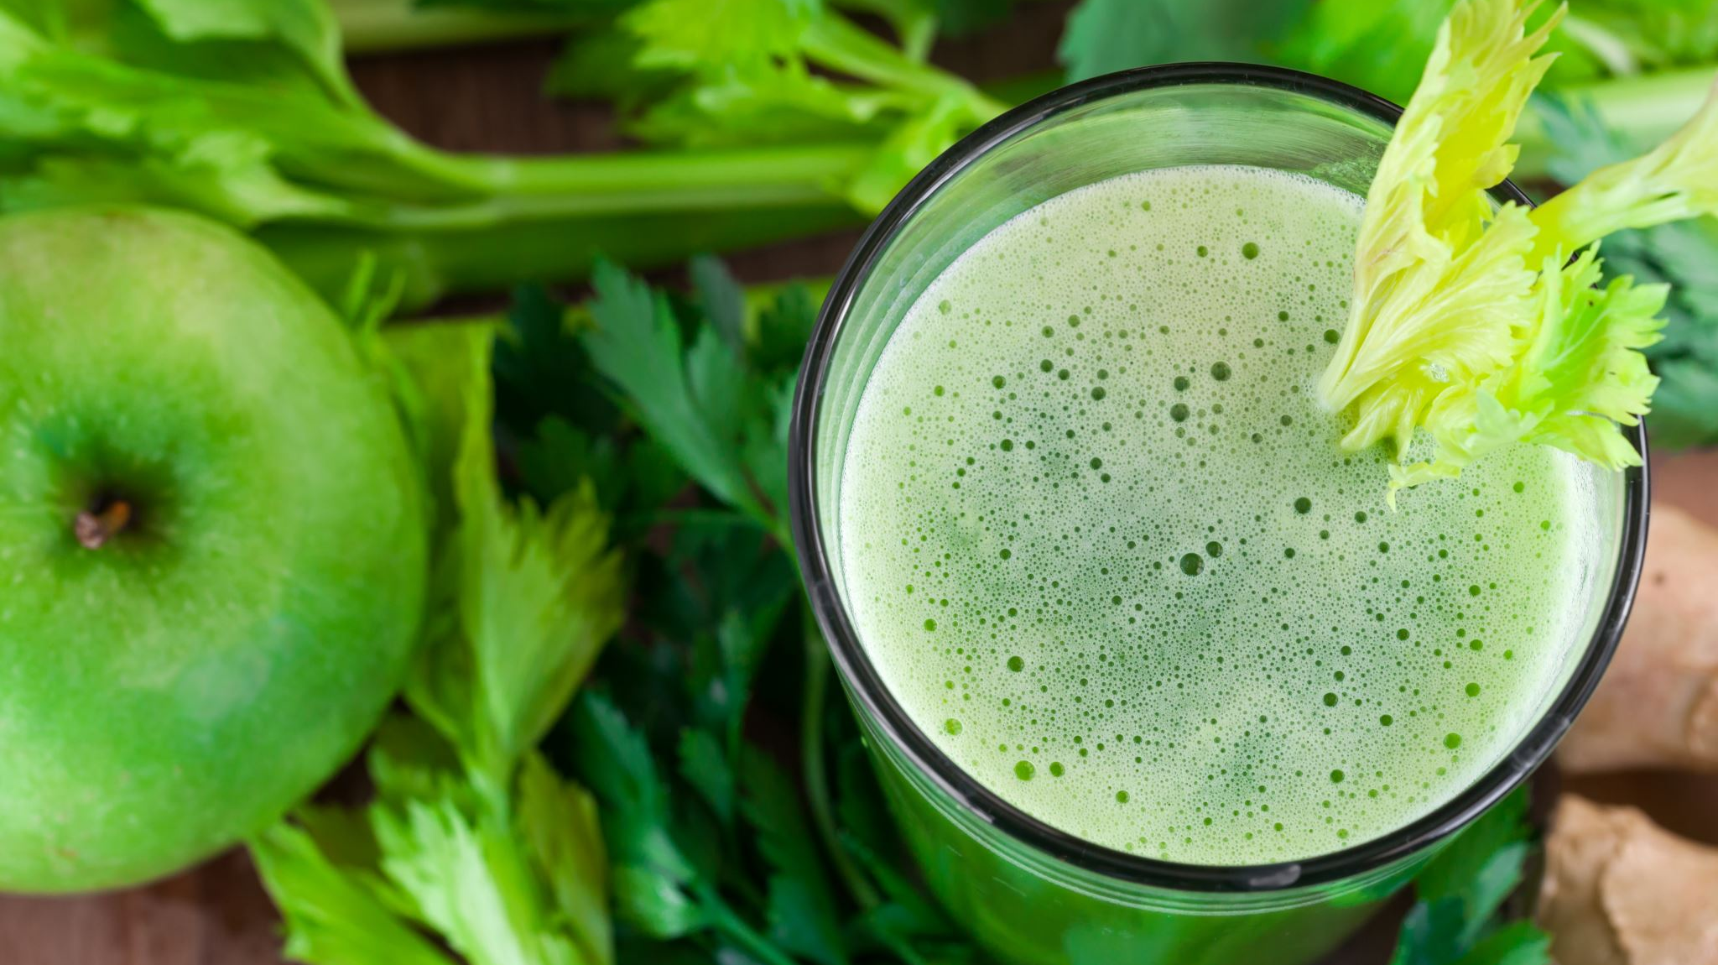
Simpson’s Paradox
38% of the residents of Roshar survive to age 70 on diet 1.
44% of Roshar residents survive on the new diet (diet 2).
65% of the residents of Tyrea survive to age 70 on diet 1.
70% of Tyrea residents survive on the new diet.
It looks like diet 2 is the better diet! The natural longevity of Tyreans made diet 1 look better than it was.

Slide 34

A motivating problem
There are two boxes.
Box 1 contains 2 gold coins and 7 cardinal coins
Box 2 contains 4 gold coins and 3 cardinal coins
You choose a box u.a.r.
From your box, you choose a coin u.a.r.
You draw a cardinal coin
What is the probability the coin came from the first box?

Slide 35


A motivating problem
E is the event that you draw a cardinal coin.
F is the event that you draw from box 1.
Calculating p(E|F) is easy ($7/9$)
We want to calculate p(F|E) (much harder!)

Slide 36


A motivating problem
$$p\left(F | E\right)= \frac{p(E∩F)}{p(E)}$$
$$p\left(F | E\right)∙p\left(E\right)=p\left(E∩F\right)=p\left(E | F\right)∙p\left(F\right)$$
$$p\left(F | E\right)=\frac{p(E|F)∙p(F)}{p(E)}$$
Bayes’ Theorem:
$$p\left(F | E\right)=\frac{p(E|F)∙p(F)}{p\left(E | F\right)∙p\left(F\right)+p(E|\overline{F})∙p(\overline{F})}$$

Slide 37

A motivating problem
$$p\left(F\right)=p\left(\overline{F}\right)= 1/2$$
$$p\left(E | F\right)= 7/9$$
$$p\left(E | \overline{F}\right)=3/7$$
$$p\left(F | E\right)=\frac{7/9∙1/2}{7/9∙1/2+3/7∙1/2}=64\%$$

Slide 38
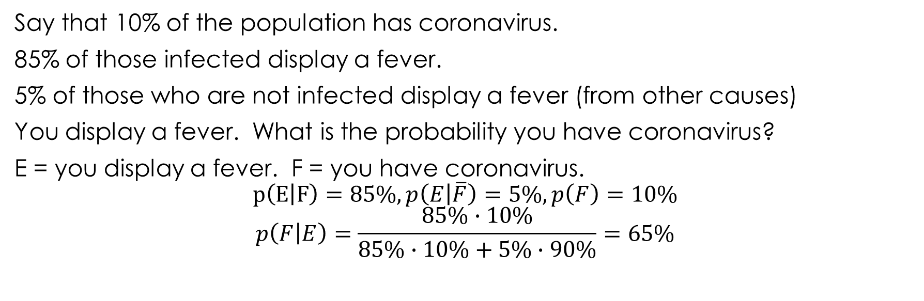
Practice
Say that 10% of the population has coronavirus.
85% of those infected display a fever.
5% of those who are not infected display a fever (from other causes)
You display a fever. What is the probability you have coronavirus?
E = you display a fever. F = you have coronavirus.
$$p\left(E | F\right)=85\%,p\left(E | \overline{F}\right)=5\%, p\left(F\right)=10\%$$
$$p\left(F | E\right)=\frac{85\%∙10\%}{85\%∙10\%+5\%∙90\%}=65\%$$

Slide 39

Oddities from Bayes’ Theorem
Suppose there is a much rarer disease that infects 1 out of 100,000 people. You have a very accurate test for the disease:
If you have the disease, it correctly says so 99% of the time.
If you don’t, it correctly says so 99.5% of the time.
You take the test, and it comes back positive. What is the probability you have the disease?
E = test comes back positive, F = you have the disease.
$$p\left(E | F\right)=99\%, p\left(E | \overline{F}\right)=0.5\%,p\left(F\right)=0.001\%$$
$$p\left(F | E\right)=\frac{99\%∙0.001\%}{99\%∙0.001\%+0.5\%∙99.999\%}=0.2\%???$$

Slide 40
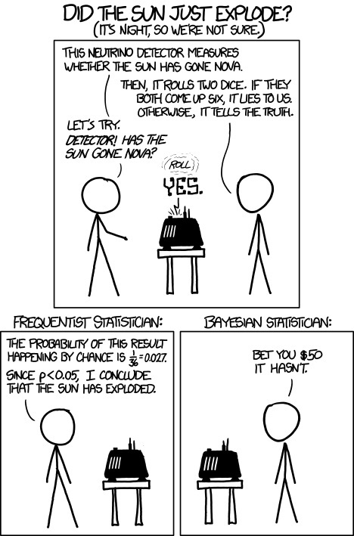
XKCD #1132 Frequentists vs. Bayesians

Slide 41

Bayes’ Theorem: Other Versions
A simpler version:
$$p\left(F | E\right)=\frac{p(E|F)∙p(F)}{p(E)}$$
A more complex version, for any partition of the sample space into distinct sets F₁, …, F_{k} :
$$p\left(F | E\right)=\frac{p(E|F)∙p(F)}{p\left(E | F1\right)∙p\left(F1\right)+ … +p\left(E | Fk\right)∙p\left(Fk\right)}$$

Slide 42

Monty Hall Revisited
There are 3 doors. You choose door 1. The host then opens door 2 to reveal a goat. What is the probability the car is behind door 3?
F_{i} = the car is behind door i. E = the host opens door 2.
$p\left(E | F3\right)=1, p\left(E | F2\right)=0$, because the host never opens the door with the car.
$p\left(E | F1\right)=1/2$, because the host can open door 2 or 3.
$$p\left(Fi\right)=1/3$$
$$p\left(F3 | E\right)=\frac{1∙1/3}{1/2∙1/3+0∙1/3+1∙1/3}=2/3$$

Slide 43


Definitions
A Random Variable is a mapping from the sample space to the set of real numbers.
That is, every single outcome is assigned a number.
If your trial is to flip 3 coins, there are 8 possible outcomes. You could have a random variable X that calculates the number of heads for each outcome: X(HHT) = 2, for example
The distribution of a random variable is the probability of each possible number.
So for the above trial:
$$p\left(0\right)=1/8=p\left(3\right)$$
$$p\left(1\right)=3/8=p(2)$$

Slide 44
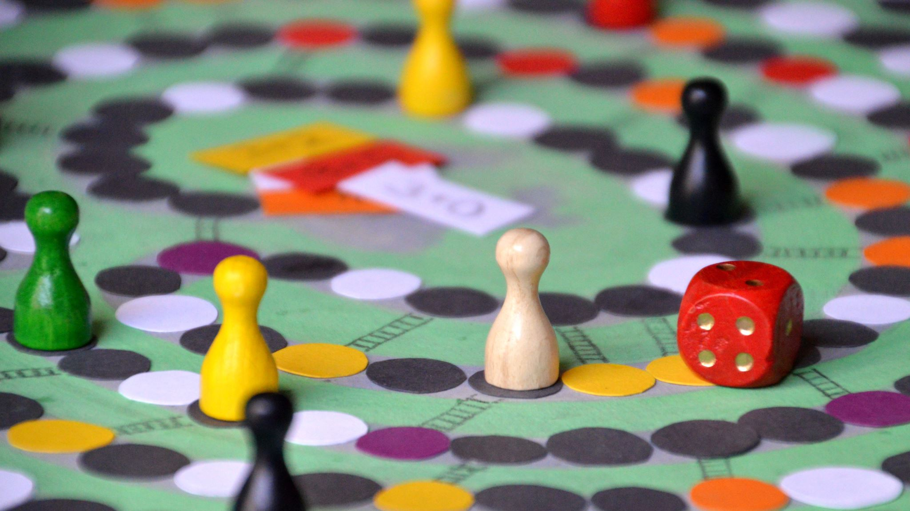

A Dice Problem
You roll two fair dice. X(t) is a random variable that outputs the sum of the dice. What is the distribution of X?
$$p\left(2\right)=1/{36}=p(12)$$
$$p\left(3\right)=2/{36}=p\left(11\right)$$
$$p\left(4\right)=3/{36}=p(10)$$
$$p\left(5\right)=4/{36}=p\left(9\right)$$
$$p\left(6\right)=5/{36}=p\left(8\right)$$
$$p\left(7\right)=6/{36}$$

Slide 45
Random Variables: Origins
In 1940, two mathematicians were planning to publish papers about random variables, and they were trying to decide what to call them by (random variable or chance variable, each preferred by one of the mathematicians).
Given the subject matter, how do you suppose they decided?
They flipped a coin, and we’ve been stuck with random variable ever since.

Slide 46


Expectation
The Expected Value E(X) of a random variable X is the average value outputted by X. That is:
$$E\left(X\right)=\sum_{s∈S}{p(s)∙X(s)}$$
What is the expected value of a fair die roll?
$$1/6∙1+1/6∙2+1/6∙3+1/6∙4+1/6∙5+1/6∙6=3.5$$
Given n Bernoulli trials, each with probability of success p, what is the expected number of successes?
np
Wait… why could we do that?

Slide 47
Linearity of Expectations
E(X₁+…+ X_{n}) = E(X₁) + … + E(X_{n})
E(a∙X + b) = a ∙ E(X) + b
That is, if you want to calculate the expected number of successes over n trials, you can calculate the expected number of successes for the 1st trial, and the 2nd trial, and the 3rd trial, etc, and add them all up.
What is the expected value of the sum of 3 fair dice?
3 ∙ 3.5 = 10.5
Professor Slacker hates grading, and just assigned each student a grade (A, B, C, or D) u.a.r. If he had actually bothered to grade, he would have given 25% of students each grade. What is the expected percentage of students that got the correct grade?
25%

Slide 48
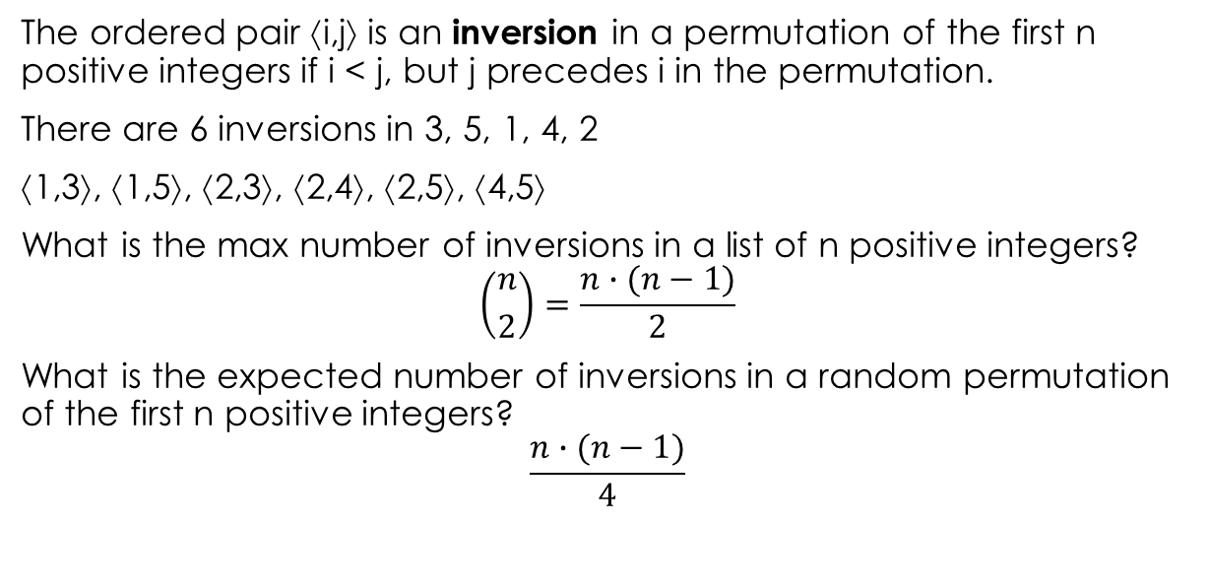
Practice
The ordered pair ⟨i,j⟩ is an inversion in a permutation of the first n positive integers if i < j, but j precedes i in the permutation.
There are 6 inversions in 3, 5, 1, 4, 2
⟨1,3⟩, ⟨1,5⟩, ⟨2,3⟩, ⟨2,4⟩, ⟨2,5⟩, ⟨4,5⟩
What is the max number of inversions in a list of n positive integers?
$$\left({n \atop 2}\right)=\frac{n∙(n−1)}{2}$$
What is the expected number of inversions in a random permutation of the first n positive integers?
$$\frac{n∙(n−1)}{4}$$

Slide 49
Expectation on Non-Independent Random Variables
You have two coins. One has heads on both sides, the other has tails on both sides.
You choose a coin u.a.r., and then you flip it twice. What is the expected number of heads?
1
Linearity of Expectations holds, even if the variables aren’t independent!

Slide 50

Insertion Sort
What is the expected number of comparisons made by Insertion Sort?
Let X_{i} be the number of comparisons to insert the i-th element.
We want to calculate E(X₁ + … + X_{n})
By Linearity of Expectations, we can just calculate E(X₁), …, E(X_{n})
E(X₁) = 0, because the first item is already in the correct position.
X₂ will always output 1, because we need to compare a₁ and a₂. E(X₂) = 1
X₃ will always output at least 1.
If we find it to be the largest element so far, it will only output 1.
Otherwise we will do another comparison with the smallest element, and it will output 2.
There are 2 cases where we do 2 comparisons (smallest and 2nd smallest)
E(X₃) $=2/3∙2+1/3∙1=5/3$

Slide 51

Insertion Sort, Continued
$E\left(X4\right)=1/4∙1+$ $1/4∙2+$ $2/4∙3=9/4$
$E\left(X5\right)=1/5∙1+1/5∙2+1/5∙3+2/5∙4={14}/5$
$E\left(X6\right)={20}/6$
$$E\left(Xi\right)=\frac{i∙\left(i+1\right)−2}{2i}$$
$$\sum_{i=1}^{n}{E(Xi})=\sum_{i=1}^{n}{\frac{i−1}{2}−\frac{1}{2i}=θ(n2)}$$

Slide 52
Hirings
n applicants are interviewed for a single job opening, 1 applicant per day.
The first applicant is automatically hired.
For every day thereafter, if the current applicant is better than the current employee, then the applicant is hired and the employee is fired.
What is the expected number of hirings?

Slide 53
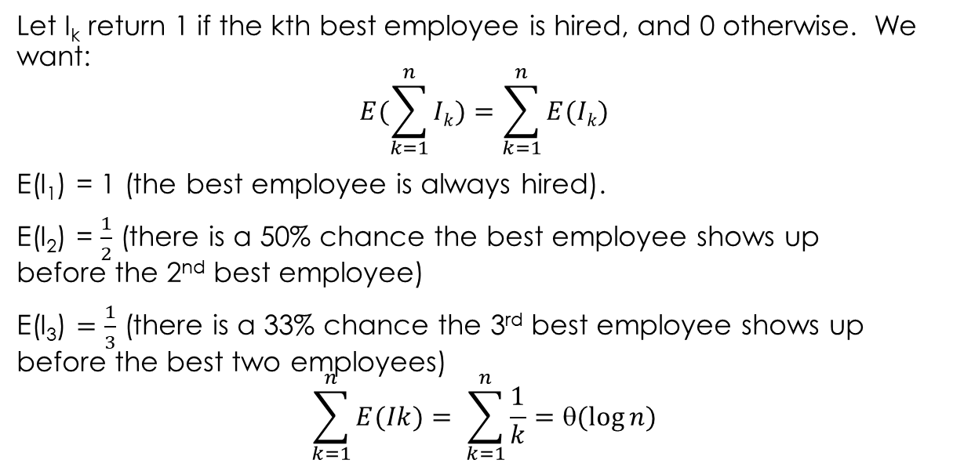
Hirings
Let I_{k} return 1 if the kth best employee is hired, and 0 otherwise. We want:
$$E(\sum_{k=1}^{n}{Ik})=\sum_{k=1}^{n}{E(Ik})$$
E(I₁) = 1 (the best employee is always hired).
E(I₂) = $\frac{1}{2}$ (there is a 50% chance the best employee shows up before the 2nd best employee)
E(I₃) $=\frac{1}{3}$ (there is a 33% chance the 3rd best employee shows up before the best two employees)
$$\sum_{k=1}^{n}{E(Ik})= \sum_{k=1}^{n}{\frac{1}{k}}=θ(\log{n)}$$

Slide 54

Hash Tables
A hash table has k buckets and n items.
Each item is distributed to buckets u.a.r., and independently from each other.
What is the expected number of empty buckets?
We can figure this out by determining the probability a specific bucket is empty.
Let B_{i} be the event where bucket i is empty.
p(B_{i}) = E(B_{i}) = $\left(\frac{k−1}{k}\right)n$
We want E(B₁ + … + B_{k})
By Linearity of Expectations, this is $k∙\left(\frac{k−1}{k}\right)n$
If n = k = 1000, this is about 368. If n =1000 and k = 10000, this is about 9048.

Slide 55


The geometric Distribution
A coin comes up heads with probability p. We will flip the coin until it comes up heads. What is the expected number of flips?
pr(X=1) = p
pr(X=2) = (1-p) ∙ p
pr(X=3) = (1-p)² ∙ p
$$E\left(X\right)=\sum_{i=1}{i∙\left(1−p\right)i−1∙p}=\frac{1}{p}$$
Because for |x| < 1:
$$\sum_{k=1}^{∞}{kxk−1=}\frac{1}{\left(1−x\right)2}$$

Slide 56

The Geometric Distribution
A random variable has the geometric distribution with parameter p : 0 ≤ p ≤ 1 if pr(X = k) = (1 - p)^{k-1} ∙ p, for all positive integers k. It has expected value $1/p$.
The probability that a randomly chosen 1000 digit number is prime is approximately $1/{2302}$. We choose a 1000 digit number u.a.r., and check if its prime. If it is, we’re done, otherwise we randomly select another (possibly different) number and repeat. What is the expected number of times we select a number?
2302
A doctor is treating coronavirus victims. On each day, she has a $1/4$ probability of catching coronavirus, a $1/8$ probability of finishing treatment for the last victim, and otherwise she comes back to work the next day. What is the expected number of days she comes in to work?
$$8/3$$

Slide 57


Multiplying Expectations
If X and Y are independent, then E(X ∙ Y) = E(X) ∙ E(Y).
If we roll two fair dice and multiply their values, what is the expected result?
3.5² = 12.25
If we roll one fair die, and square its value, what is the expected result?
E(X ∙ X) = E(X²) ≠ E(X) ∙ E(X), because X is not independent from X.
$$\frac{1}{6}\text{∙}\text{1}\text{2}\text{+}\frac{1}{6}\text{∙}2\text{2}\text{+}\frac{1}{6}\text{∙}\text{3}\text{2}\text{+}\frac{1}{6}\text{∙}\text{4}\text{2}\text{+}\frac{1}{6}\text{∙}\text{5}\text{2}\text{+}\frac{1}{6}\text{∙}\text{6}\text{2} ≈ \text{15.17}$$

Slide 58


Variance
The expected value of a random variable tells us the average, but nothing about how widely its values are distributed.
If the midterm has an average of 33, it’s possible that everyone got 33, and it’s also possible that half the class got 50 while the other half got 16. Variance is a metric that measures how widely values are distributed.
The variance of X is $$V\left(X\right)=\sum_{s∈S}{\left(X\left(s\right)−E\left(X\right)\right)2p(s)}$$
$X\left(s\right)−E\left(X\right)$ measures how much individual values vary from the average.
Squaring it heavily weights outliers: a large value will be produced if there are a lot of scores very far from the average.
An easier way to calculate variance is V(X) = E(X²) - E(X)²

Slide 59
Practice
A gambler’s coin has heads on both sides. What is the variance on the number of heads after n flips?
X is always n, X² is always n², so E(X²) – E(X)² = n² – n² = 0
That’s what you’d expect.
What is the variance on the number of successes for a single Bernoulli trial?
pr(X = 1) = p
E(X) = p ∙ 1 + (1 - p) ∙ 0 = p
E(X²) = p ∙ 1² + (1 - p) ∙ 0² = p
V(X) = E(X²) – E(X)² = p - p² = p ∙ (1 - p) = p ∙ q

Slide 60
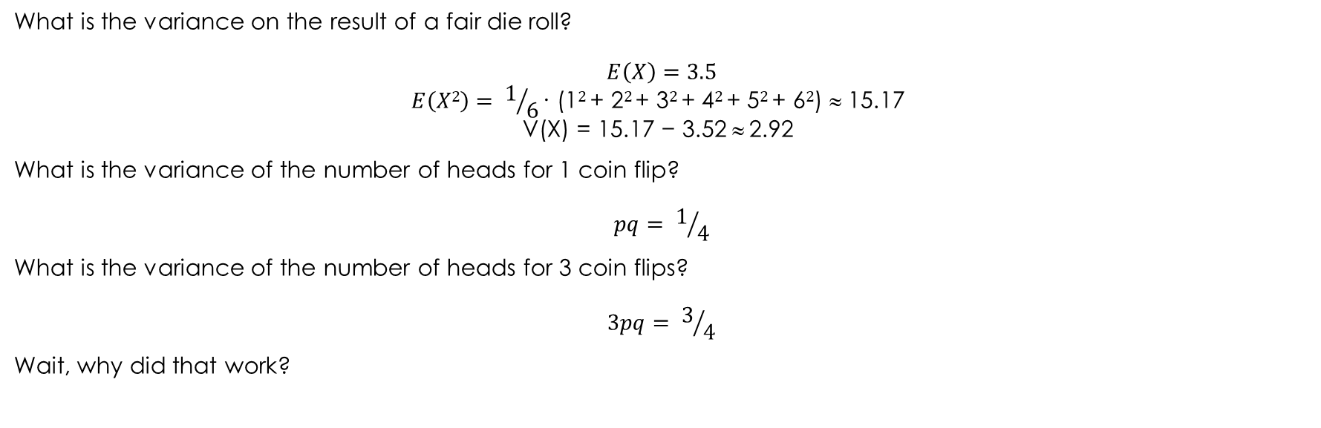
Practice
What is the variance on the result of a fair die roll?
$$E\left(X\right)=3.5$$
$$E\left(X2\right)= 1/6\text{∙}\text{ (1}2 \text{+ 2}2 \text{+ 3}2 \text{+ 4}2 \text{+ 5}2 \text{+ 6}2\text{) }≈\text{ 15.17 }$$
$$\text{V}\text{(}\text{X}\text{) = 15.17 − 3.52} ≈ \text{2.92 }$$
What is the variance of the number of heads for 1 coin flip?
$$pq= 1/4$$
What is the variance of the number of heads for 3 coin flips?
$$3pq= 3/4$$
Wait, why did that work?

Slide 61
Bienayme’s Formula
If X₁, …, X_{n} are pairwise independent random variables, then:
V(X₁ + … + X_{n}) = V(X₁) + … + V(X_{n})
What is the variance on the number of successes over n Bernoulli trials?
npq

Slide 62
Standard Deviation
The standard deviation of a random variable is the square root of its variance.
This is used for test statistics quite frequently.
If you assume that test scores follow a specific type of distribution known as the bell curve (which is often the case for well-constructed tests), then the standard deviation tells you how many students fall within a specific range of scores.
94% will fall within +/- 2 standard deviations
68% will fall within +/- 1 standard deviations

Slide 63
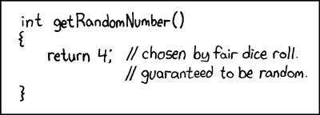
XKCD #221

